Slide 1



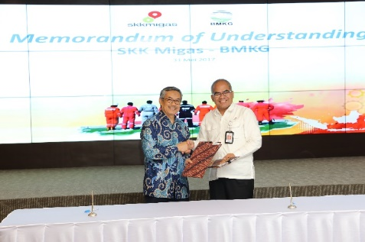

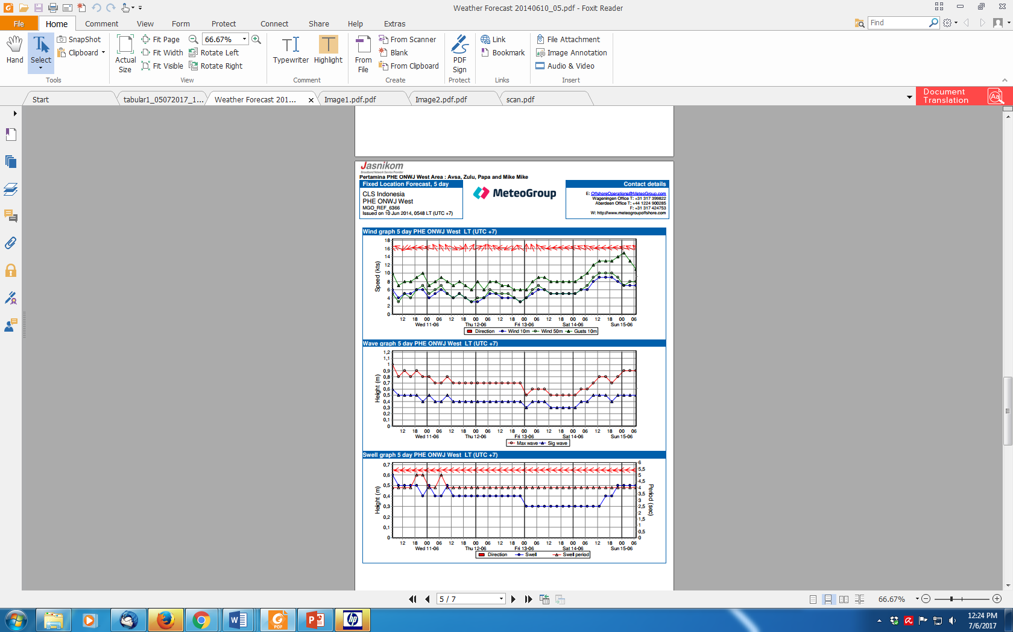
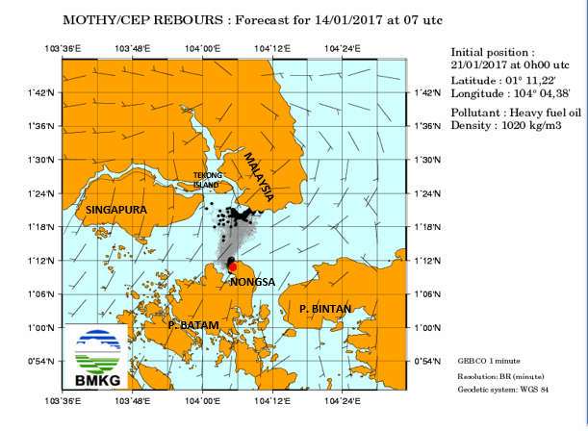
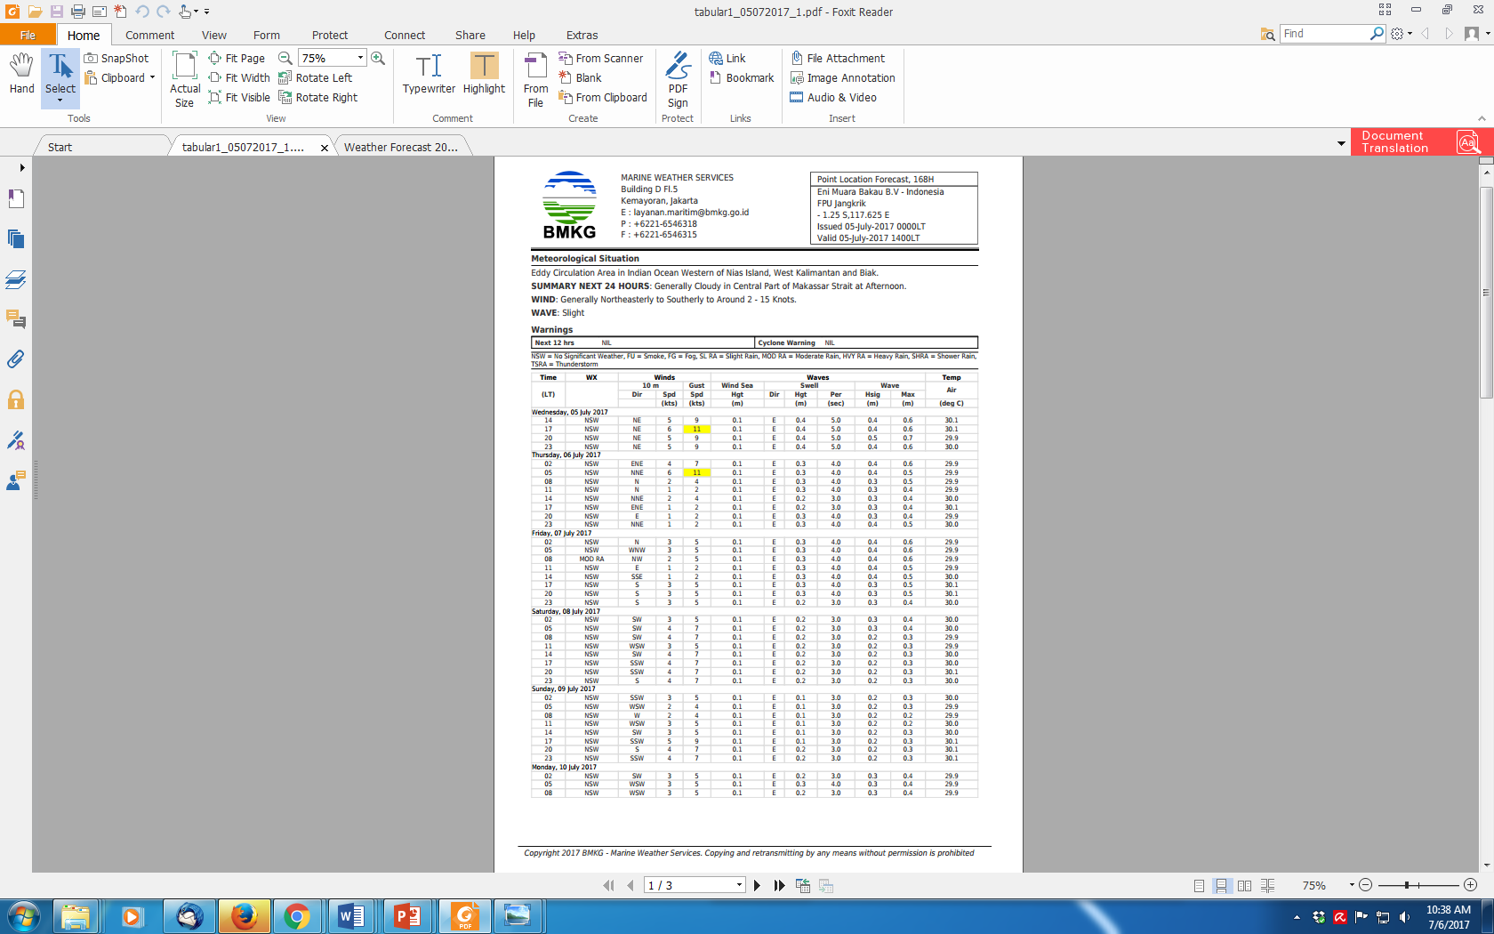
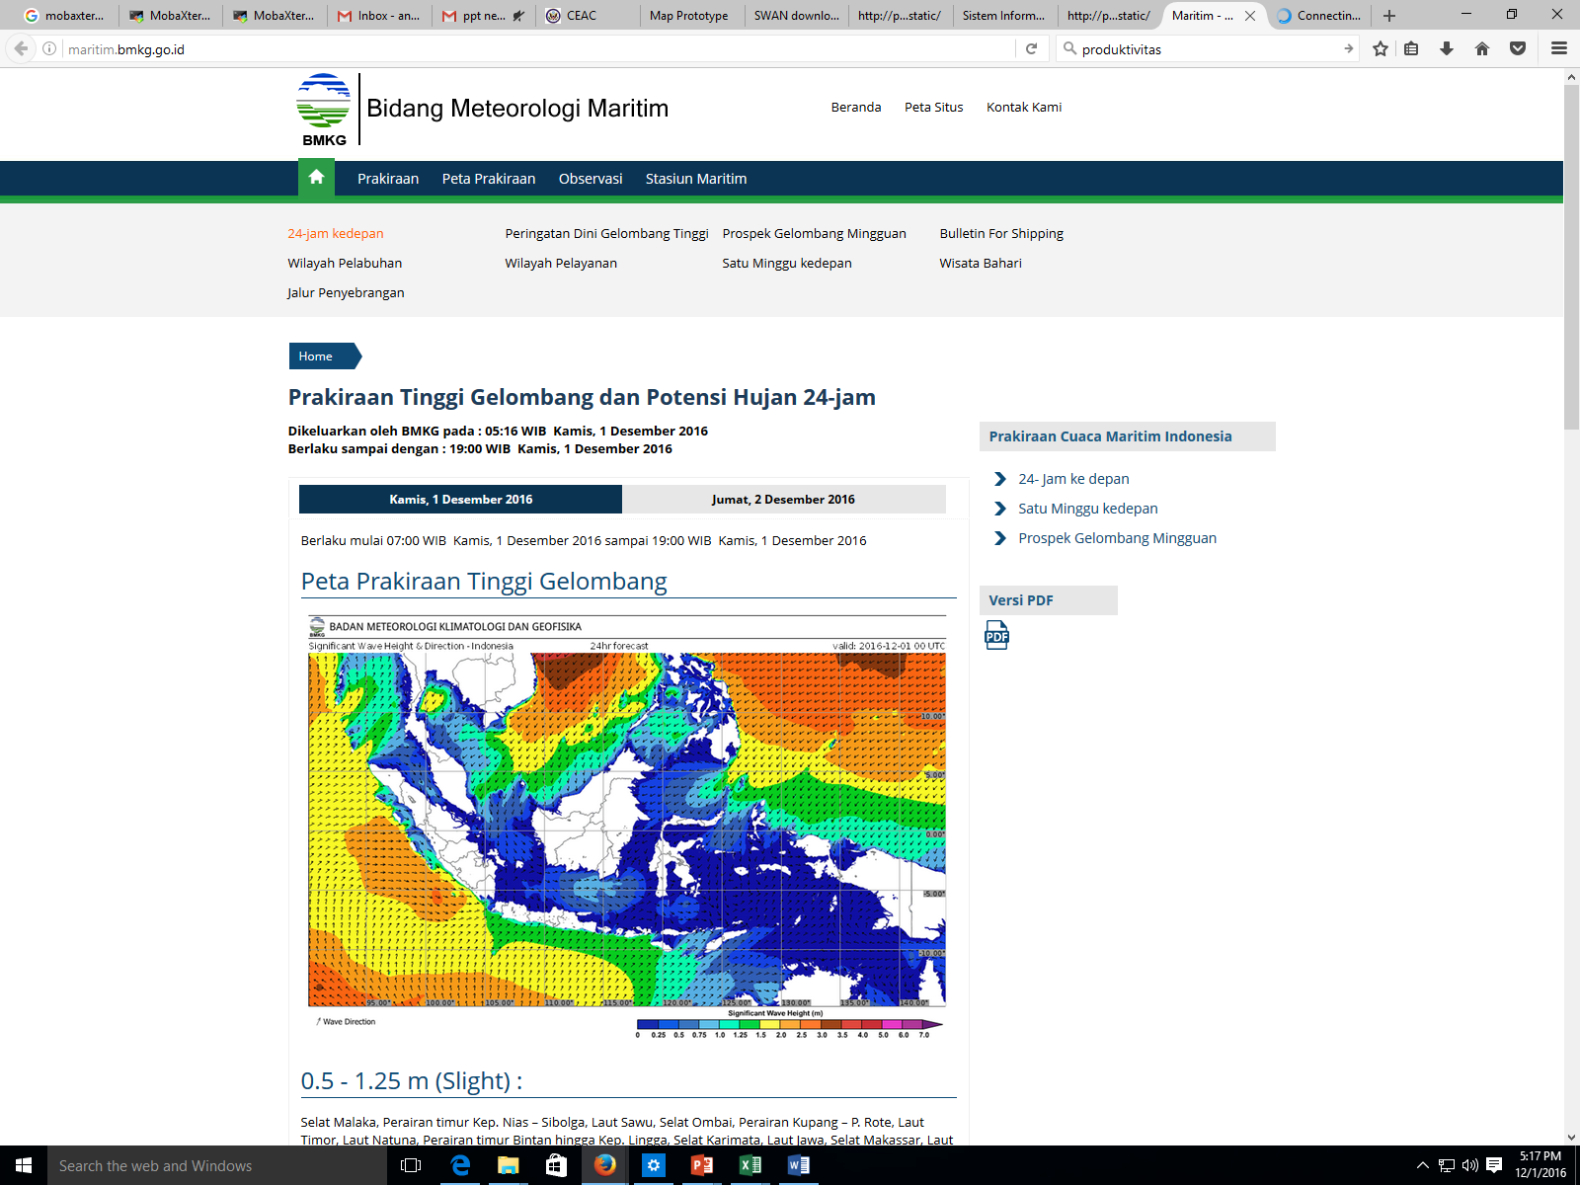
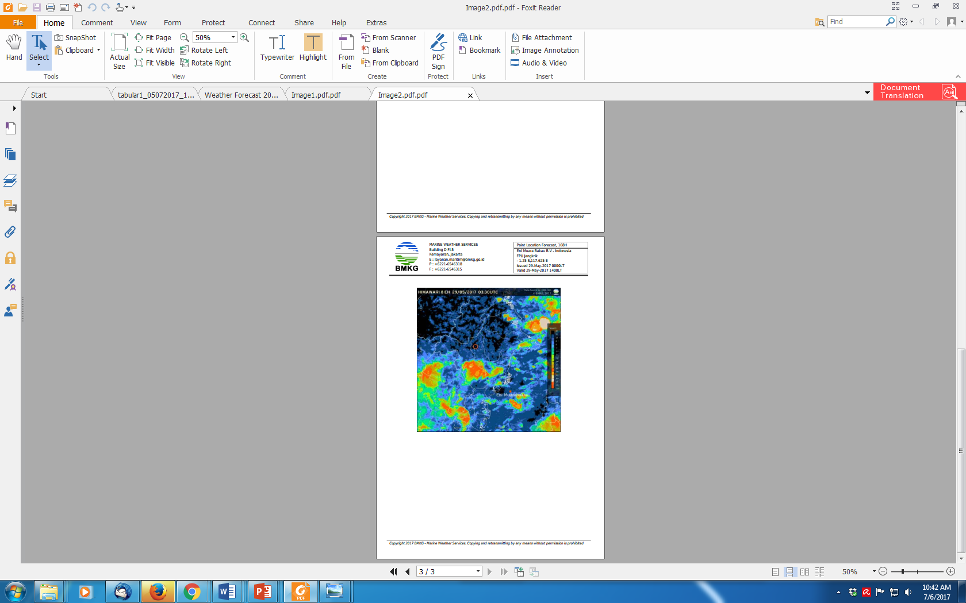
INTRODUCTION TO R PROGRAMMING
WIDO HANGGORO

Slide 2


What is R?
R is a programming language and free software environment used for statistical computing, data analysis, and graphical representation.
Developed by Ross Ihaka and Robert Gentleman in 1993 at the University of Auckland, New Zealand.
Nowadays R is maintained by the R Development Core Team.

Slide 3
Why R?
Why is so popular?
R is open source and freely available.
R is available for Windows, Mac and Linux operating systems.
R has an extensive and coherent set of tools for statistical analysis.
R has an extensive and highly flexible graphical facility capable of producing publication quality figures.
R has an expanding set of freely available ‘packages’ to extend R’s capabilities.
R has an extensive support network with numerous online and freely available documents.

Slide 4
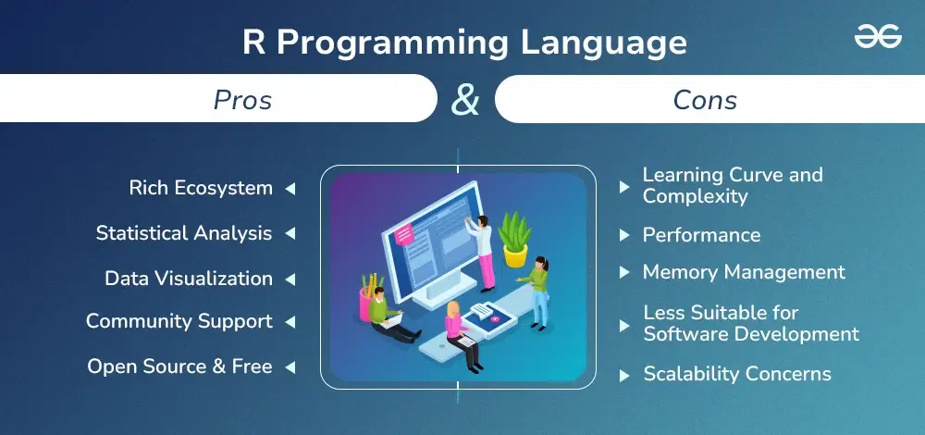

Slide 5
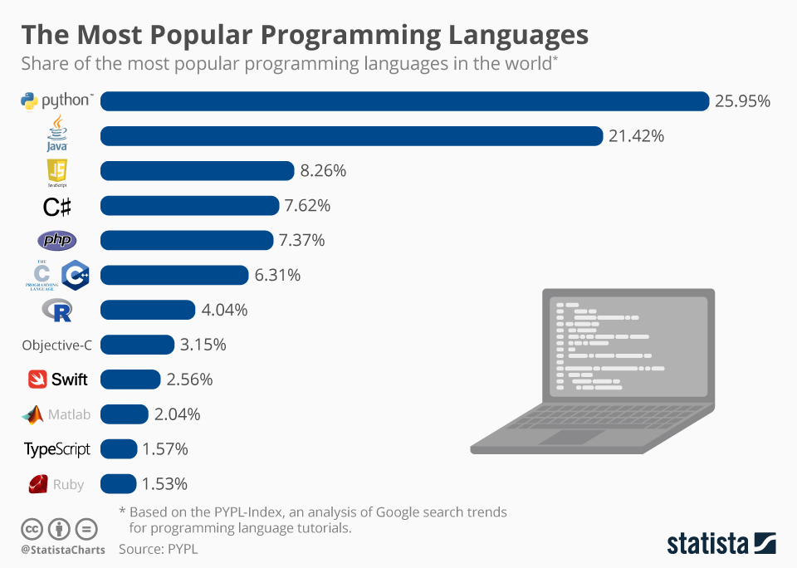

Slide 6
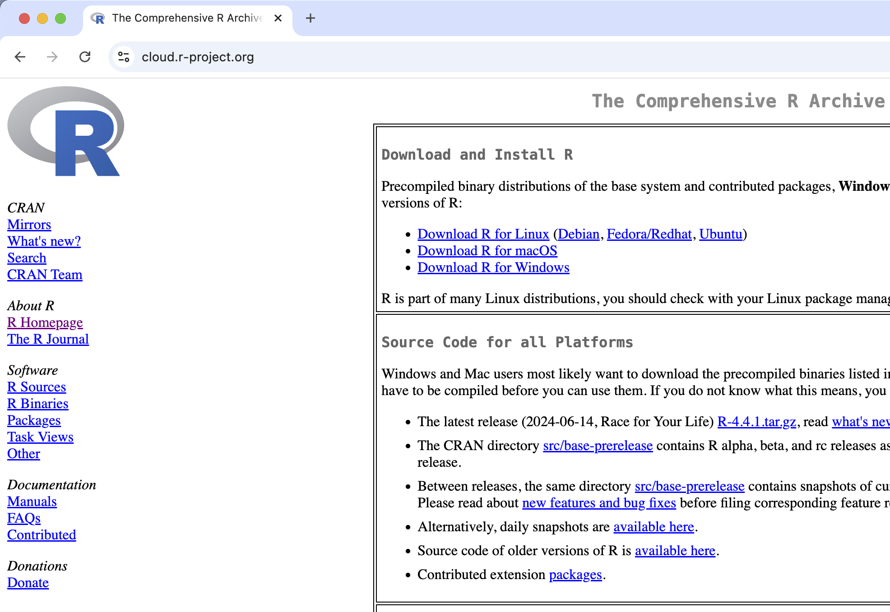
R and Rstudio Installation

Slide 7
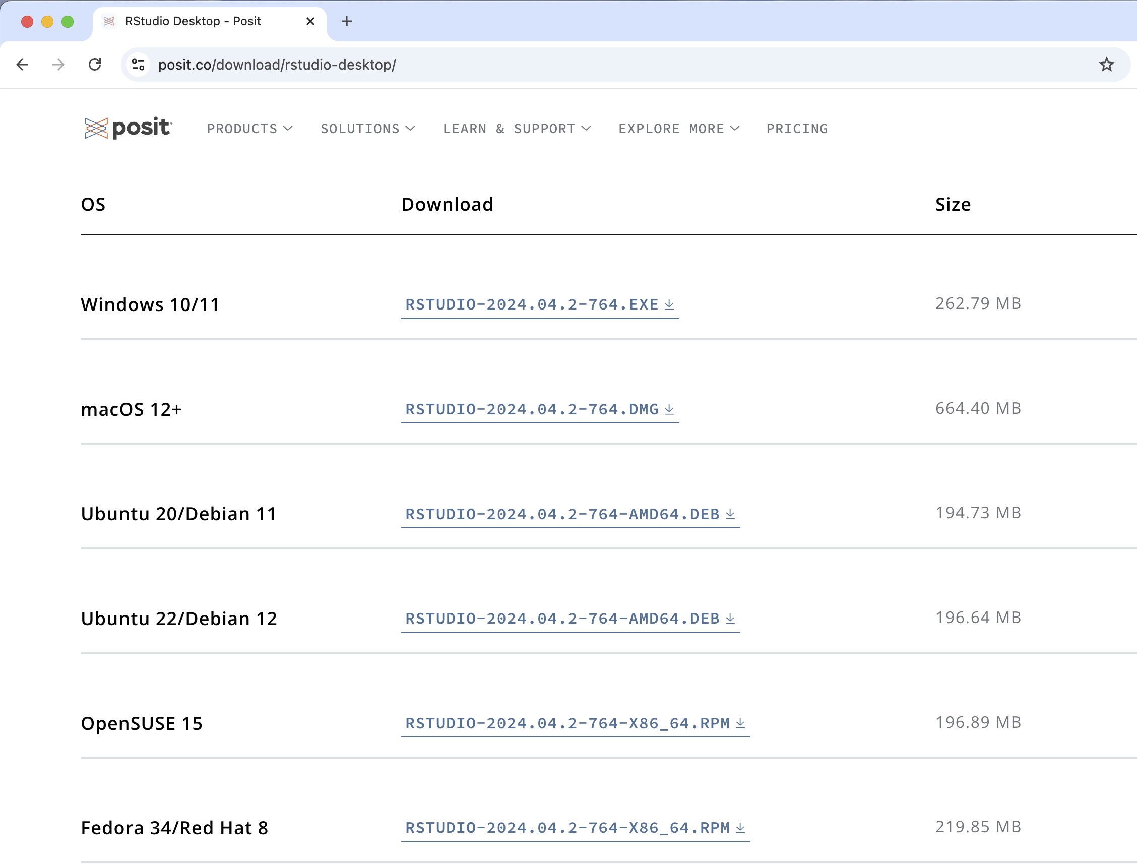

Slide 8
For Windows and Mac users, once downloaded, double click on the file icon and follow the on-screen instructions to guide you through the necessary steps.
For linux users (need sudo access),
sudo apt update or sudo yum update
sudo apt install r-base r-base-dev or sudo yum install R
To install RStudio, go to the RStudio Download page. Once it’s downloaded, double click the file to install it.

Slide 9
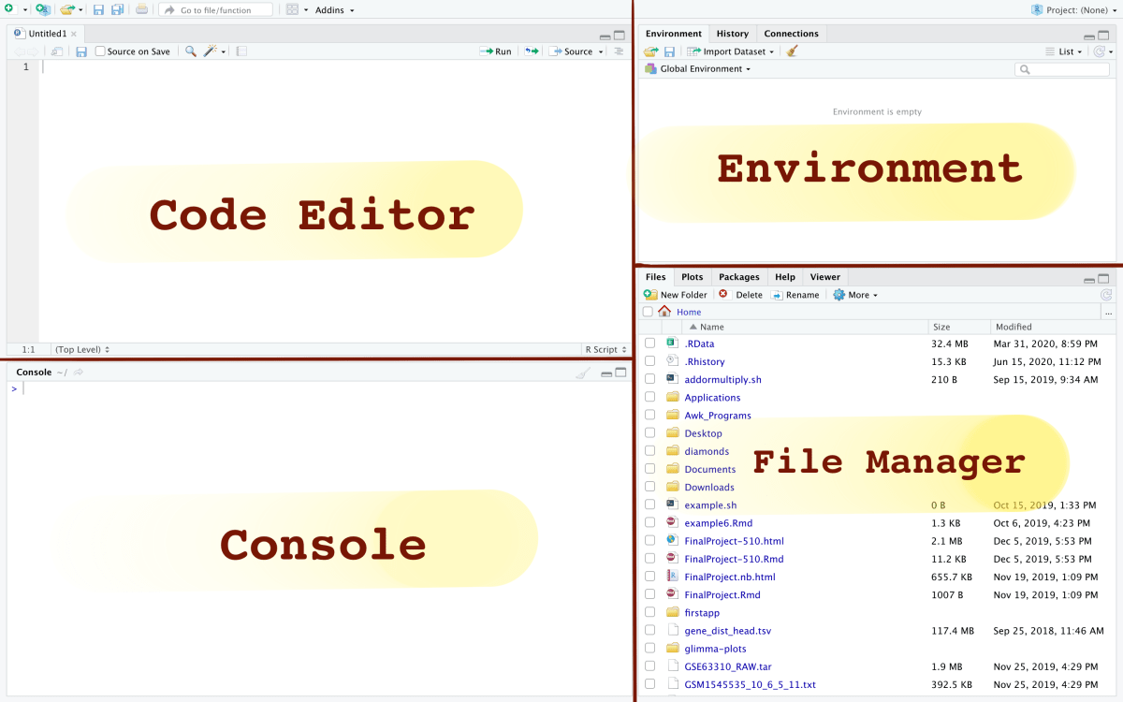
Rstudio Environment

Slide 10
Code editor = This is the area in the interface that you can write lines of your code.
The console = The console is the place in your RStudio that actually executes the commands. Scripts that are run in the code editor will be sent to and executed in the console.
Output Visualization, File Manager, Library Manager, and Help Desk
Plots: You can visualize the output of each code block you run in the console.
Files: You can manage your file system by choosing the Files tab on the menu.
Packages: When you install a package, you can see it updated in this tab.
Help: This is an incredibly useful resource on RStudio! You can search for any command or package in this tab to read its manual.
Environment = Your workspace shows you what values you have available.

Slide 11
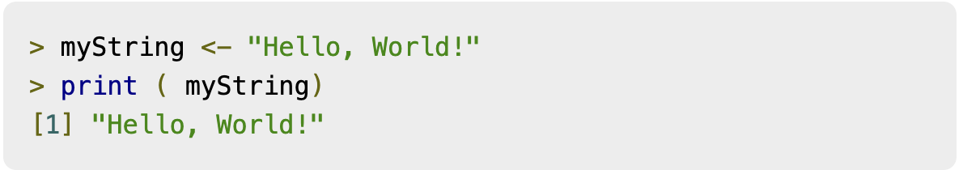
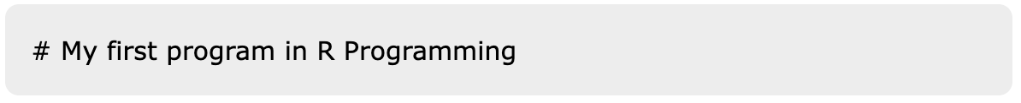
Basic syntax
When you start Rstudio, please look at the console section. You will get a prompt > where you can start typing your program as follows
To write a single comment, use # at the beginning of the statement, as shown below.
source : https://www.tutorialspoint.com

Slide 12
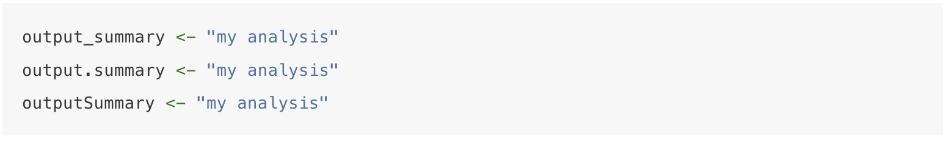
An object name cannot begin with a number or a dot followed by a number (for example, 2my_variable or.2my_variable). Avoid using non-alphanumeric characters in your object names (e.g. &, ^, /,!, etc.). Furthermore, avoid naming your objects with reserved words (e.g., TRUE, NA), and never name your object the same as a built-in function.
source : https://https://intro2r.com/

Slide 13
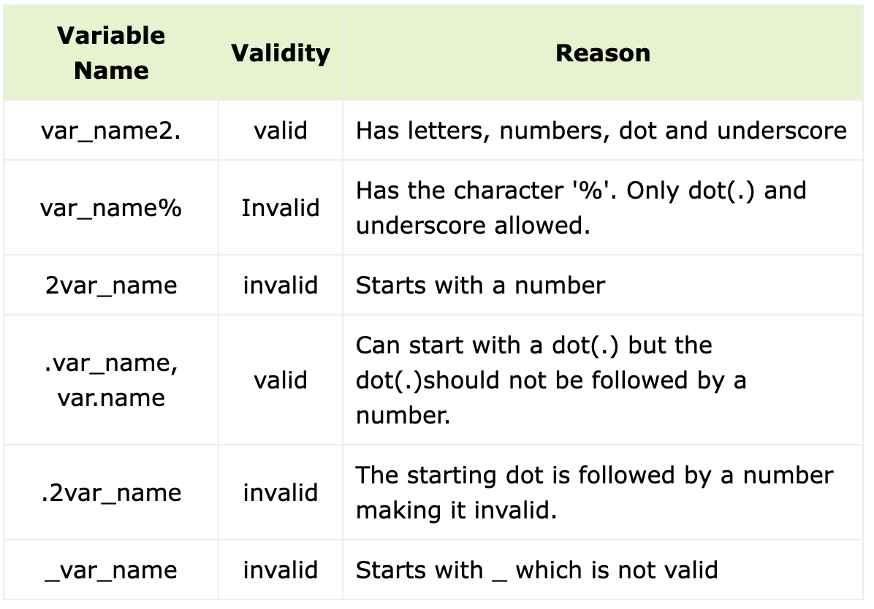
source : https://www.tutorialspoint.com

Slide 14
Data type
Numeric data are numbers that contain a decimal (12.3, 5, 999).
Integers are whole numbers (2L, 34L, 0L).
Logical data take on the value of either TRUE or FALSE (TRUE, FALSE).
Character data are used to represent string values ('a' , '"good", "TRUE", '23.4').

Slide 15
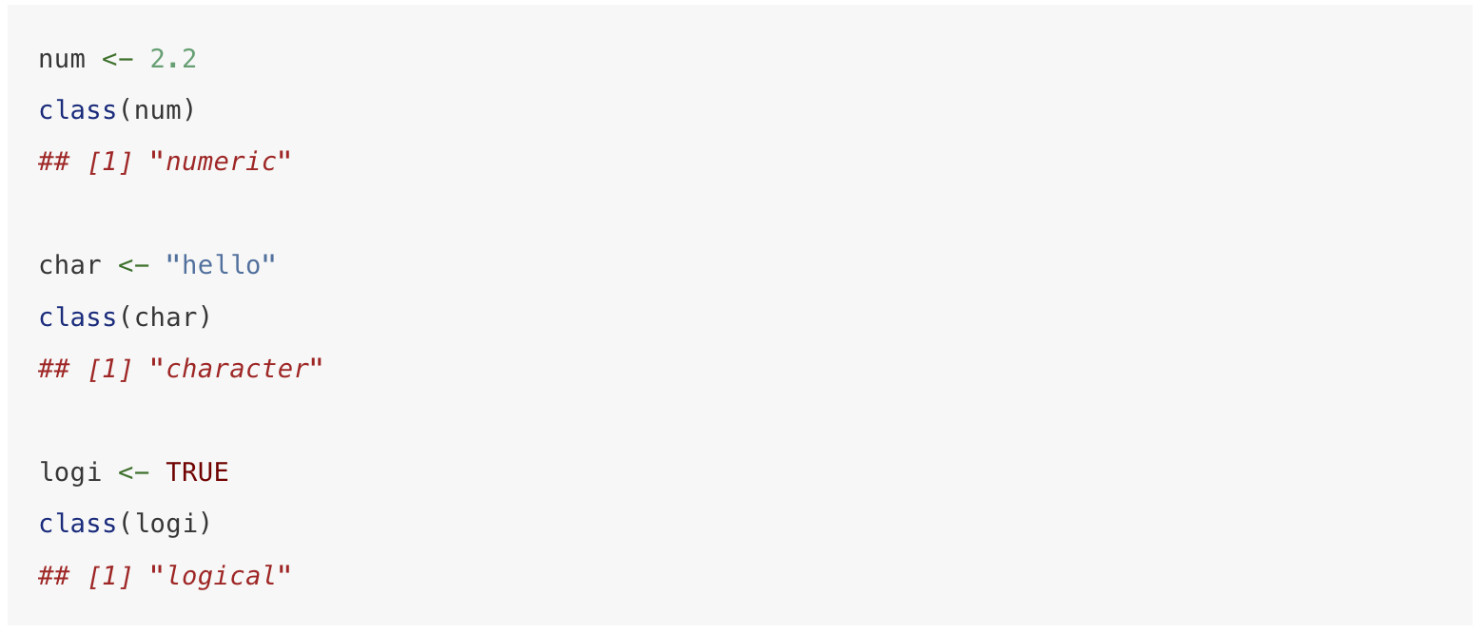
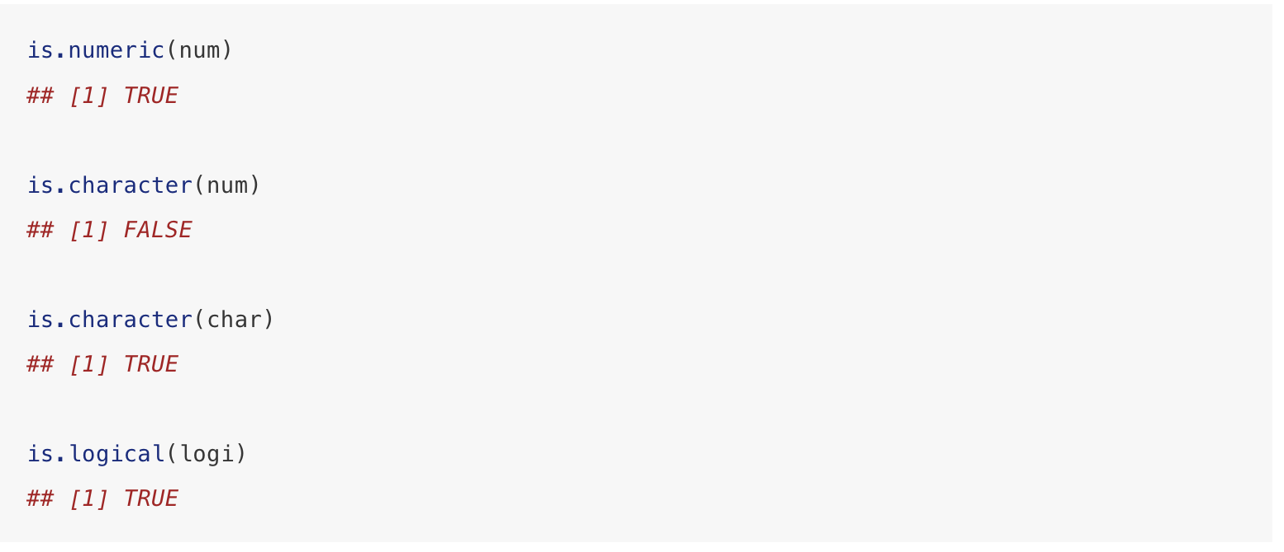
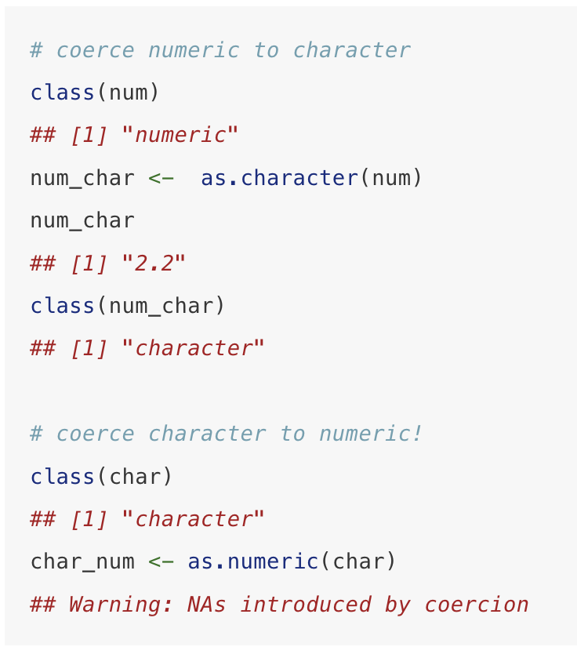

Slide 16
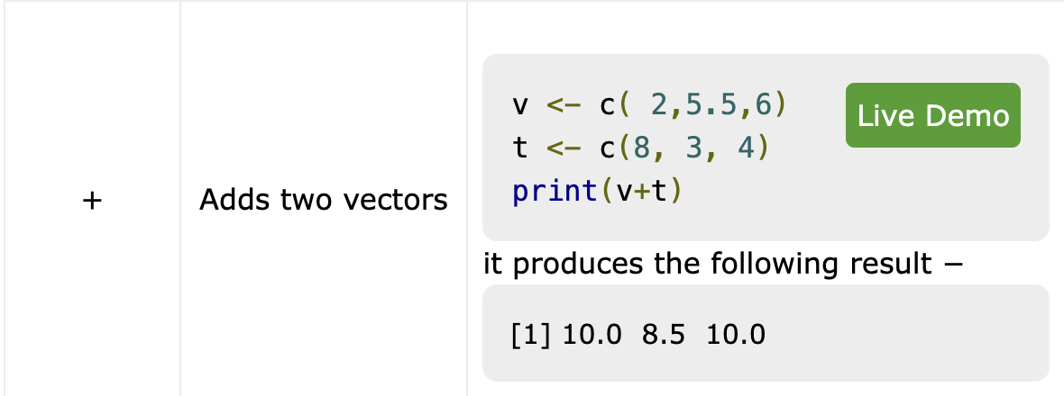
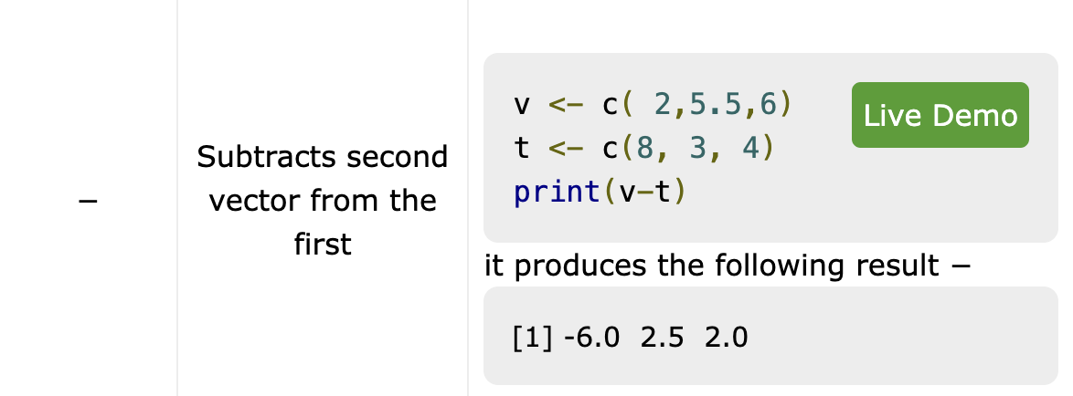
Operator type
Arithmetic operator
source : https://www.tutorialspoint.com

Slide 17
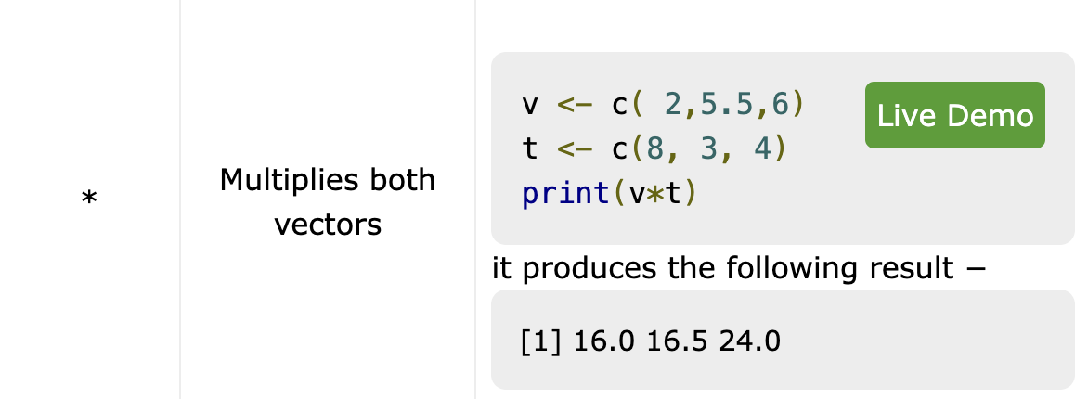
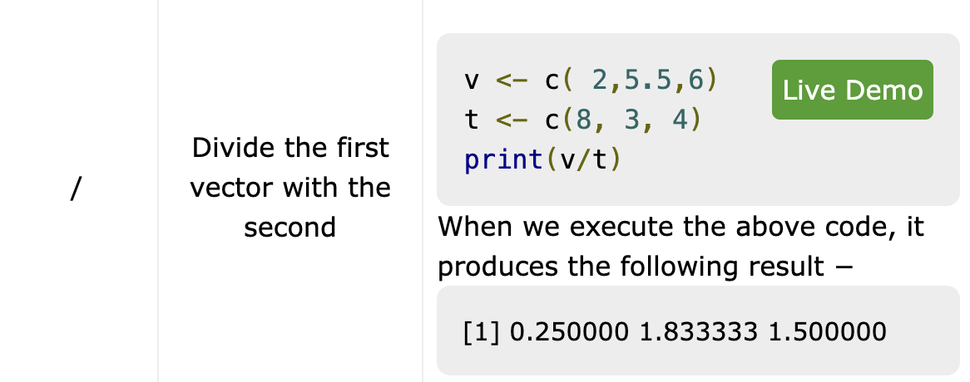

Slide 18
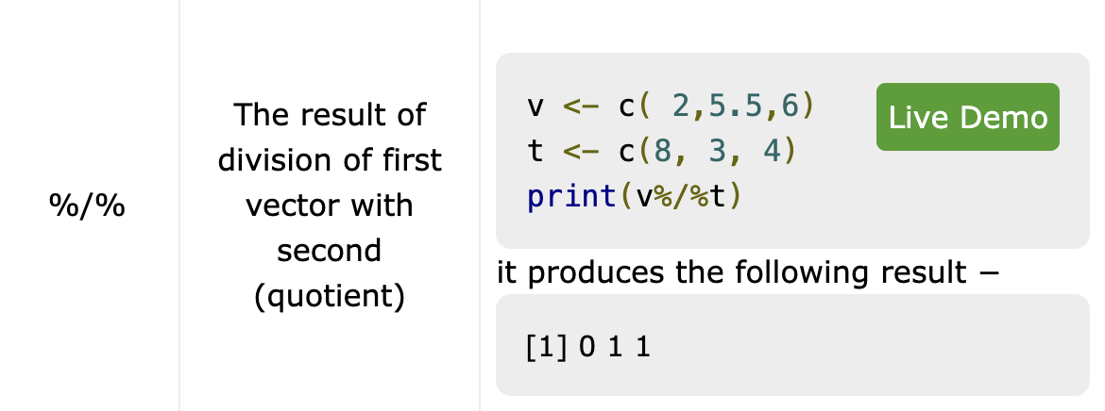
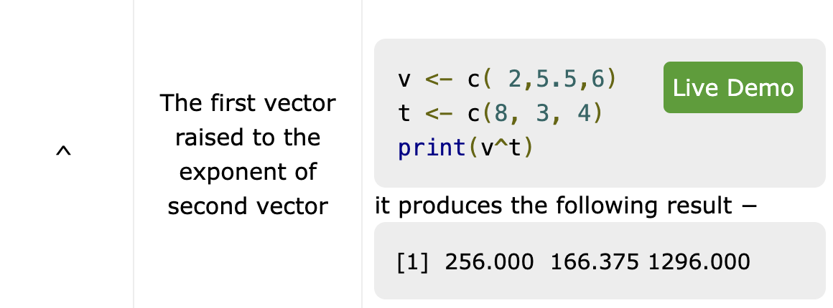

Slide 20
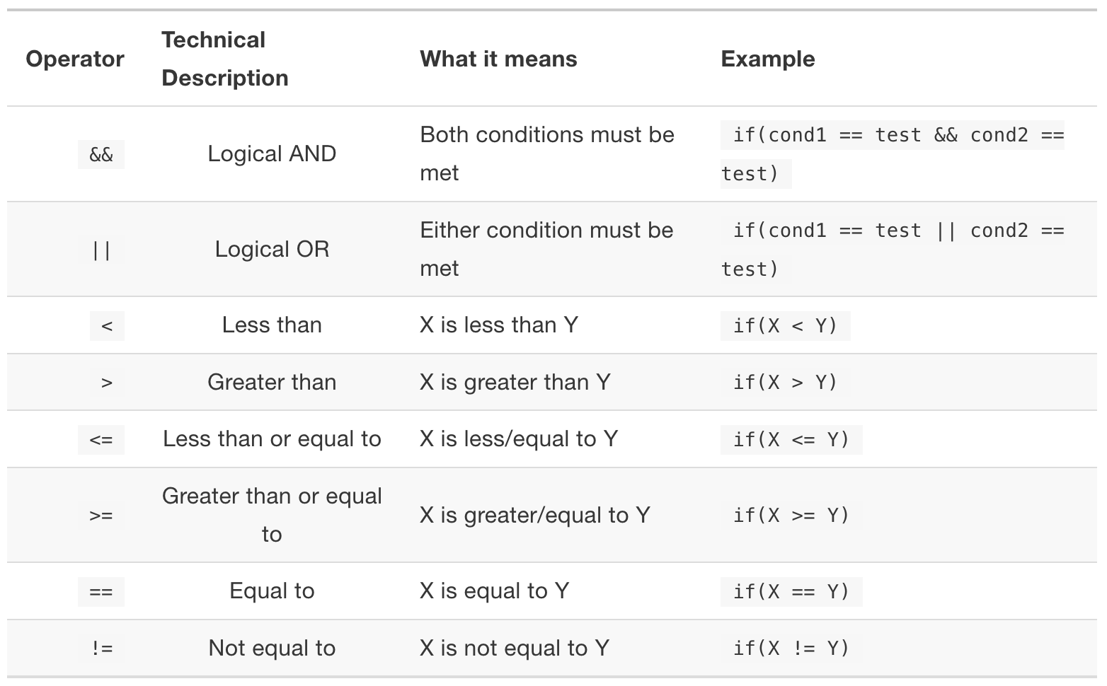
Relational operators

Slide 21
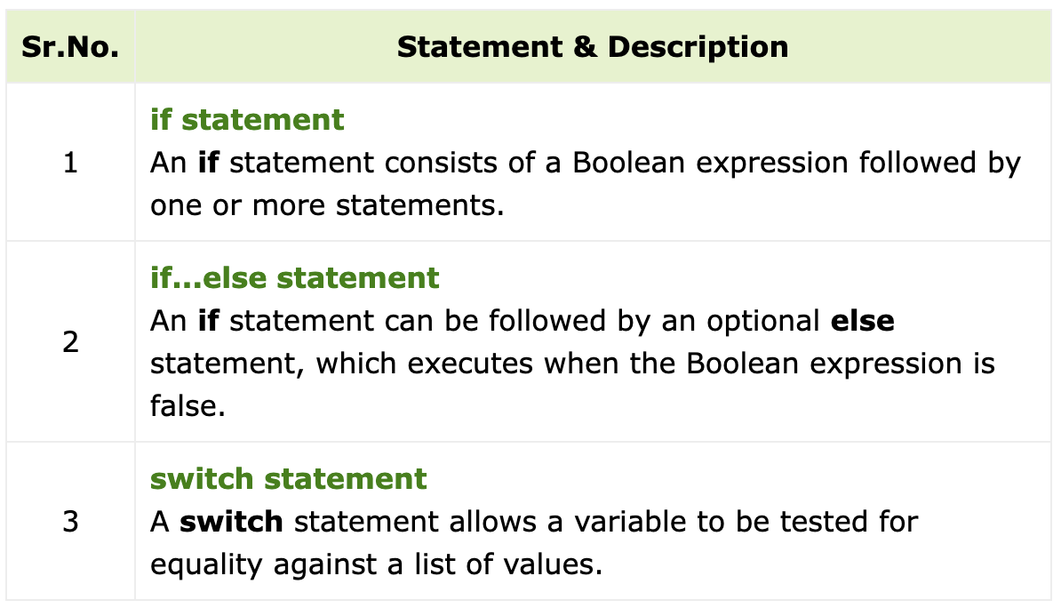
Decision making

Slide 22
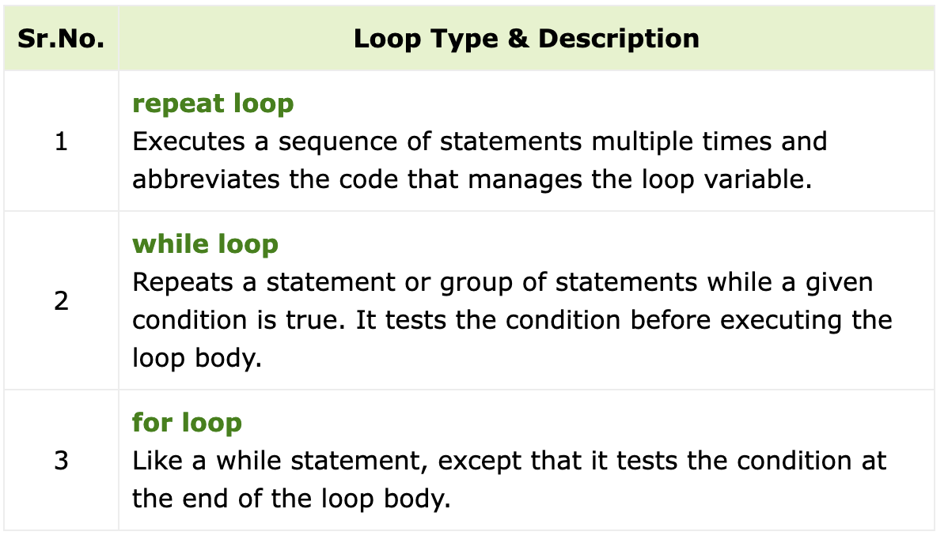
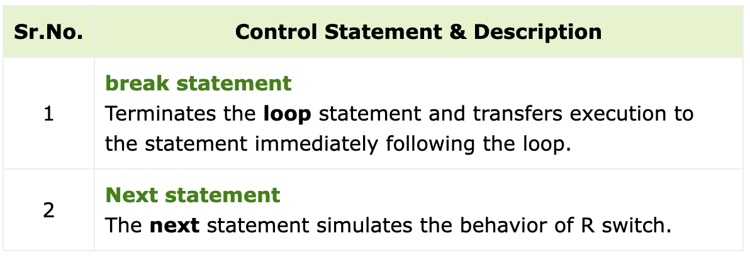
Loop

Slide 23
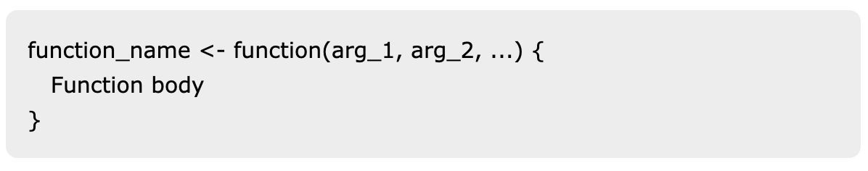
Function (User defined)
A function is a set of statements organized together to perform a specific task. R has a large number of in-built functions and the user can create their own functions.

Slide 24
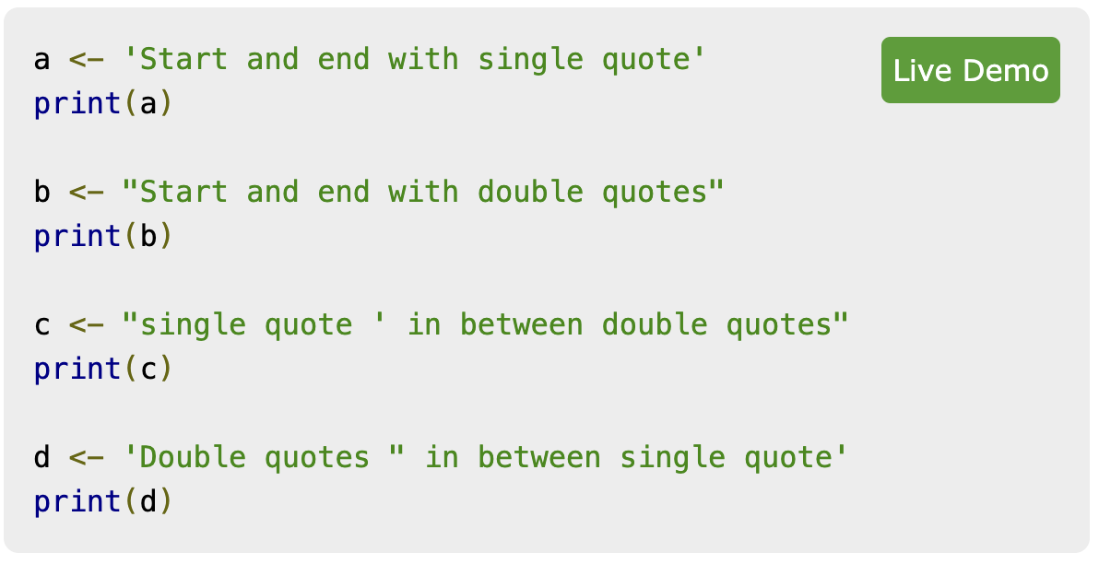
Strings
Any value written within a pair of single quote or double quotes in R is treated as a string. Internally R stores every string within double quotes, even when you create them with single quote.

Slide 25
Vector
A vector is a sequence of data elements of the same basic type. Members in a vector are officially called components. Nevertheless, we will just call them members.
They are logical, integer, double, complex, character and raw.

Slide 26
List
Lists are the R objects which contain elements of different types like − numbers, strings, vectors and another list inside it. A list can also contain a matrix or a function as its elements. List is created using list() function.

Slide 27
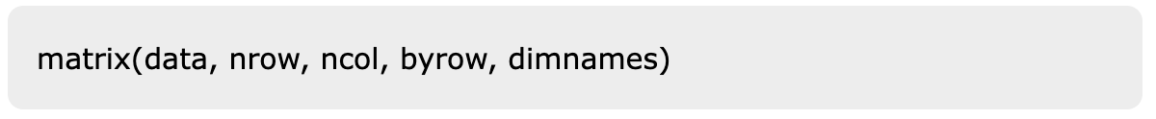
Matrices
Matrices are the R objects in which the elements are arranged in a two-dimensional rectangular layout. They contain elements of the same atomic types. Though we can create a matrix containing only characters or only logical values, they are not of much use. We use matrices containing numeric elements to be used in mathematical calculations.

Slide 28
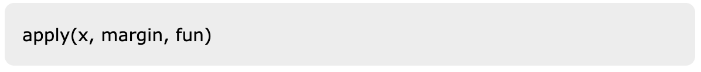
Array
Arrays are the R data objects which can store data in more than two dimensions. For example − If we create an array of dimension (2, 3, 4) then it creates 4 rectangular matrices each with 2 rows and 3 columns. Arrays can store only data type.
We can do calculations across the elements in an array using the apply() function.

Slide 29
Factors
Factors are the data objects which are used to categorize the data and store it as levels. They can store both strings and integers. They are useful in the columns which have a limited number of unique values. Like "Male, "Female" and True, False etc. They are useful in data analysis for statistical modeling.

Slide 30
Data frame
A data frame is a table or a two-dimensional array-like structure in which each column contains values of one variable and each row contains one set of values from each column.
Following are the characteristics of a data frame.
The column names should be non-empty.
The row names should be unique.
The data stored in a data frame can be of numeric, factor or character type.
Each column should contain same number of data items.

Slide 31
Read external data sources
In R, we can read data from files stored outside the R environment. We can also write data into files which will be stored and accessed by the operating system. R can read and write into various file formats like csv, excel, xml etc.

Slide 32
Terima Kasih

